Slide 1
Indian Airports – Understanding the Revenue Regime
LINK LEGAL
India Law Services
New Delhi|| Mumbai || Hyderabad || Bangalore || Chennai

Slide 2
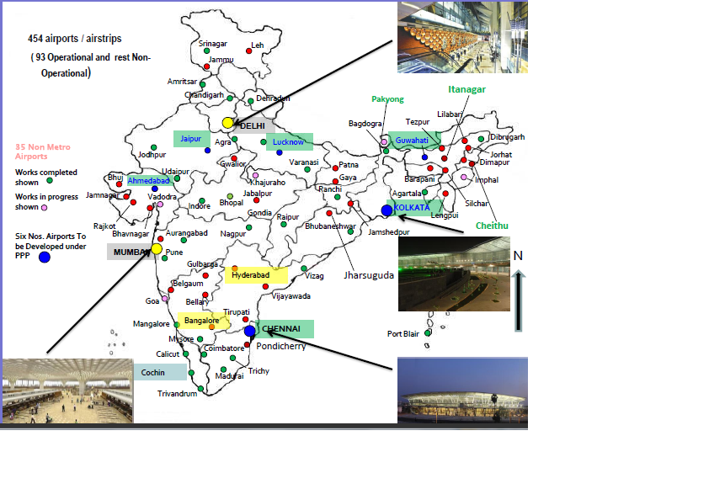
Existing Airport Infrastructure
LINK LEGAL
INDIA LAW SERVICES

Slide 3
Growth and Future
LINK LEGAL
INDIA LAW SERVICES
Increase in airports
12th five year plan – 17 Greenfield and 6 Brownfield airports in the near future.
India is 9th largest aviation market globally – to become 3rd largest aviation market by 2020 - domestic pax - 209 mn. and international pax - 60 mn. by 2017.
Passenger handling - Market size
Five international airports completed by PPP model – Estimated investment to increase by 66.7 % to USD 9.3 bn.
Rising PPP and investment
Easing of FDI norms
From September 2012, FDI of 49% in air transport services permitted. 100% FDI allowed in airports.
MRO hub
Growth upto USD 1.5 bn. estimated by 2020. 100% FDI in MRO.

Slide 4
Regulatory Scenario
LINK LEGAL
INDIA LAW SERVICES
Regulatory Bodies/Sectoral Policies
  Directorate General of Civil Aviation - DGCA
  Airport Infrastructure Policy
Key Regulations (with rules issued thereunder)
  Airports Authority of India Act, 1994
  Aircraft Act, 1934
  The Airport Economic Regulatory Authority of India Act, 2008
  Other applicable legislation including the FEMA, environmental laws, labour, taxation
Proposed Legislations - Civil Aviation Authority of India Bill, 2012

Slide 5
Regulatory Overview
LINK LEGAL
INDIA LAW SERVICES
MOCA
DGCA & BCAS
AERA Act, 2008
Aircraft Act, 1934
AAI Act, 1994
Steering Committee (SA)
AAI Airports
AAI
Green Field Policy
Site Clearance by SA
Airport Co. Airports
In-principle approval from SA
Brown-field airport - AAI can assign to any third party
DGCA license
MOCA – Ministry of civil aviation
AERA - Airports Economic Regulatory Authority
DGCA – Director General of Civil Aviation
AAI – Airport Authority of India
Proposal referred to MOCA

Slide 6
Economic Regulation
LINK LEGAL
INDIA LAW SERVICES
No airport regulatory authority at the time of signing of the concession agreement
Section 13 of AERA Act
Delhi/Mumbai – existing rates were valid for one year from April 2006 and then with revision of 10 percent after the first year and determination by AERA thereafter
White paper/consultation paper issued by AERA for all airports pursuant to which tariff orders were passed for Delhi and Mumbai.
(order 13 and 14 issued by AERA list out the regulatory philosophy and approach to regulate airport operators)

Slide 7
Economic Regulator - AERA
LINK LEGAL
INDIA LAW SERVICES
AERA determines the tariff for aero services taking the following into consideration:
Capital expenditure incurred and timely investment in improvement of airport activities;
The services provided, its quality and other relevant factors;
The cost of improving efficiency;
Economic and viable operation of major airports;
Revenue received from services other than the aeronautical services;
The concession offered by the Central Government in any agreement or MoU or otherwise; and
Any other factor which may be relevant.

Slide 8
Popular Till Models
LINK LEGAL
INDIA LAW SERVICES
Light touch
Single Till
Dual till
Hybrid Till

Slide 9
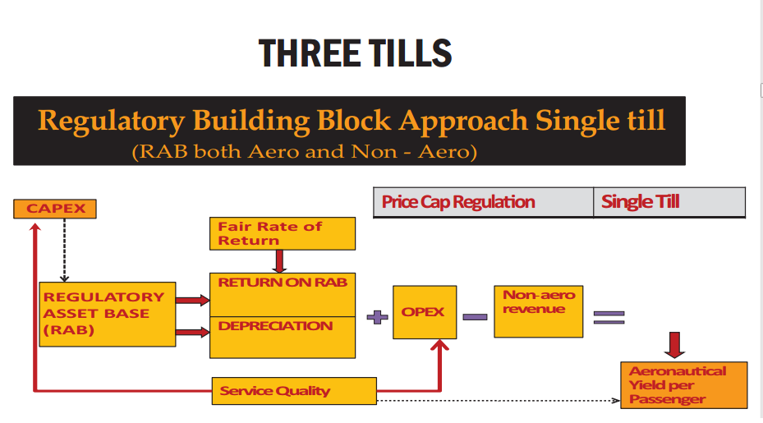
Single Till
LINK LEGAL
INDIA LAW SERVICES
Light touch
Single Till
Dual till
Hybrid Till

Slide 10
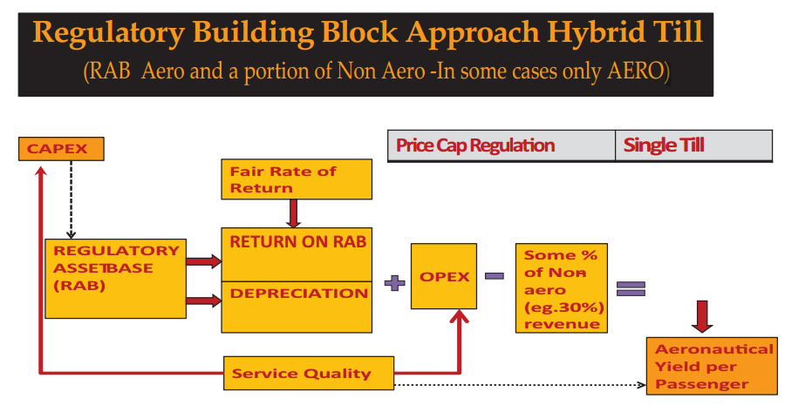
Hybrid Till
LINK LEGAL
INDIA LAW SERVICES
Light touch
Single Till
Dual till
Hybrid Till

Slide 11
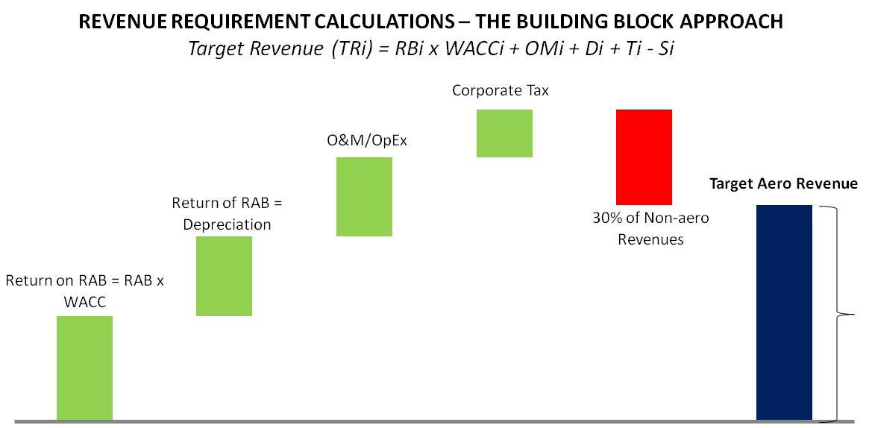
Hybrid Till
LINK LEGAL
INDIA LAW SERVICES

Slide 12
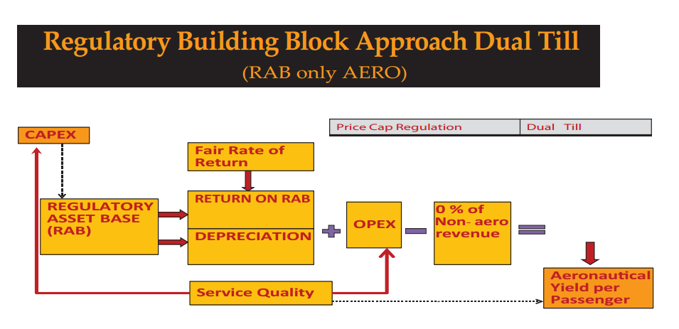
Dual Till
LINK LEGAL
INDIA LAW SERVICES
Light touch
Single Till
Dual till
Hybrid Till

Slide 13
Greenfield Airports
LINK LEGAL
INDIA LAW SERVICES
Existing Model
Concession granted by the Ministry of Civil Aviation.
Exclusivity – No new airport development within 150 kms. radius.
Right to collect aero and non-aero revenues.
Pay revenue share to AAI – For GHIAL @ 4% on the gross revenue;
For BIAL @ 4% on the gross revenue.
Tariff determination by AERA every 5 years or earlier, if required.
Single Till approach of tariff determination by AERA:
  Entire airport is considered to be one unit;
  Pre-determined rate of return for the concessionaire; and
  Profits from non-aero activities used to offset the aero cost base for determining airport charges.

Slide 14
Brownfield Airports
LINK LEGAL
INDIA LAW SERVICES
Existing Model
Lease of Airport to the Concessionaire under Section 12(4) of AAI Act.
ROFR for development of new airport within 150 kms. radius.
Right to collect aero and non-aero revenues.
Pay revenue share to AAI – For DIAL @ 46% on the gross revenue; For MIAL @ 38.7% on the gross revenue.
Tariff determination by AERA every 5 years or earlier, if required
Hybrid Till approach of tariff determination by AERA:
  Only aero charges are regulated;
  Non-aero charges are not regulated; and
  30% of the non-aero revenues are accounted for subsidising the aero charges .

Slide 15
Brownfield Airports
LINK LEGAL
INDIA LAW SERVICES
Proposed Model – RFQ Stage
License of Airport to the Concessionaire.
AAI may provide grant to the Concessionaire by way of equity support in accordance with the bids received.
Right to collect aero charges as per prescribed rates. Collect non-aero revenue and revenue from city side real estate.
Revenue share payment to commence from the 20th year of the COD, and to increase by 1% every subsequent year.
Tariff review by AERA every 5 years or earlier, if required on the basis of the following considerations (without limitation):
  Traffic growth, RoI and costs incurred in operations; and
  Adjustments and recoveries under the concession.
  City side premium

Slide 16
Challenges to airports
LINK LEGAL
INDIA LAW SERVICES
Current Experience
  No single window approval process; multiple stakeholder communities
  Stringent timelines for development
  Heavy performance related penalties; service delivery depended on sovereign functions
  Encroachments across airport land
  Brownfield development; poor state of existing infrastructure
  Availability of skilled manpower in airport development and operations
  Lack of industry status granted; non-availability of lending at preferred rates
  Conflicts
    Developers v. AERA
    Concession Agreement v. AERA Act

Slide 17
Thank You
LINK LEGAL
India Law Services
New Delhi|| Mumbai || Hyderabad || Bangalore || Chennai

